Slide 1
Apache Spark Performance Troubleshooting at Scale: Challenges, Tools and Methods
Luca Canali, CERN
#EUdev2

Slide 2

About Luca
Computing engineer and team lead at CERN IT
Hadoop and Spark service, database services
Joined CERN in 2005
17+ years of experience with database services
Performance, architecture, tools, internals
Sharing information: blog, notes, code
@LucaCanaliDB – http://cern.ch/canali

Slide 3
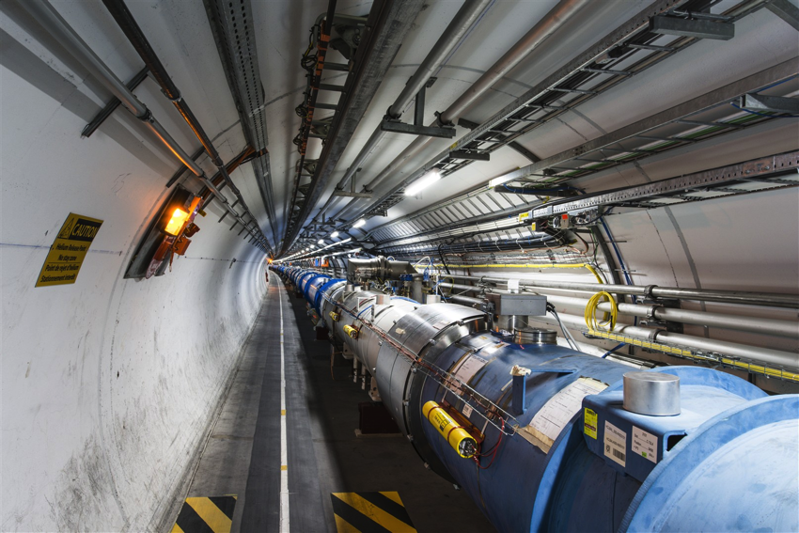

CERN and the Large Hadron Collider
Largest and most powerful particle accelerator

Slide 4

Apache Spark @
Spark is a popular component for data processing
Deployed on four production Hadoop/YARN clusters
Aggregated capacity (2017): ~1500 physical cores, 11 PB
Adoption is growing. Key projects involving Spark:
Analytics for accelerator controls and logging
Monitoring use cases, this includes use of Spark streaming
Analytics on aggregated logs
Explorations on the use of Spark for high energy physics
Link: http://cern.ch/canali/docs/BigData_Solutions_at_CERN_KT_Forum_20170929.pdf

Slide 5
Motivations for This Work
Understanding Spark workloads
Understanding technology (where are the bottlenecks, how much do Spark jobs scale, etc?)
Capacity planning: benchmark platforms
Provide our users with a range of monitoring tools
Measurements and troubleshooting Spark SQL
Structured data in Parquet for data analytics
Spark-ROOT (project on using Spark for physics data)

Slide 6
Outlook of This Talk
Topic is vast, I will just share some ideas and lessons learned
How to approach performance troubleshooting, benchmarking and relevant methods
Data sources and tools to measure Spark workloads, challenges at scale
Examples and lessons learned with some key tools

Slide 7

Challenges
Just measuring performance metrics is easy
Producing actionable insights requires effort and preparation
Methods on how to approach troubleshooting performance
How to gather relevant data
Need to use the right tools, possibly many tools
Be aware of the limitations of your tools
Know your product internals: there are many “moving parts”
Model and understand root causes from effects

Slide 8
Anti-Pattern: The Marketing Benchmark
The over-simplified benchmark graph
Does not tell you why B is better than A
To understand, you need more context and root cause analysis

Slide 9



Benchmark for Speed
Which one is faster?
20x 10x 1x

Slide 10



Adapt Answer to Circumstances
Which one is faster?
20x 10x 1x
Actually, it depends..

Slide 11
Active Benchmarking
Example: use TPC-DS benchmark as workload generator
Understand and measure Spark SQL, optimizations, systems performance, etc

Slide 12
Troubleshooting by Understanding
Measure the workload
Use all relevant tools
Not a “black box”: instrument code where is needed
Be aware of the blind spots
Missing tools, measurements hard to get, etc
Make a mental model
Explain the observed performance and bottlenecks
Prove it or disprove it with experiment
Summary:
Be data driven, no dogma, produce insights

Slide 13
Actionable Measurement Data
You want to find answers to questions like
What is my workload doing?
Where is it spending time?
What are the bottlenecks (CPU, I/O)?
Why do I measure the {latency/throughput} that I measure?
Why not 10x better?

Slide 14

Measuring Spark
Distributed system, parallel architecture
Many components, complexity increases when running at scale
Optimizing a component does not necessarily optimize the whole

Slide 15
Spark and Monitoring Tools
Spark instrumentation
Web UI
REST API
Eventlog
Executor/Task Metrics
Dropwizard metrics library
Complement with
OS tools
For large clusters, deploy tools that ease working at cluster-level
https://spark.apache.org/docs/latest/monitoring.html

Slide 16
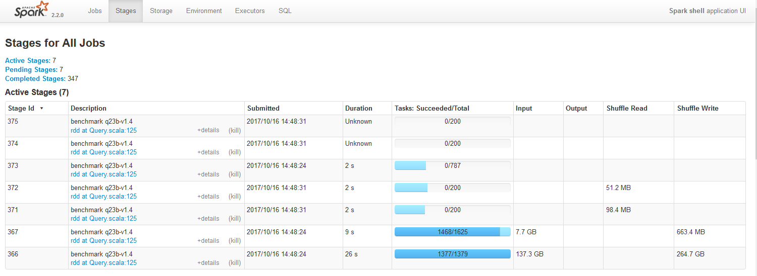
Web UI
Info on Jobs, Stages, Executors, Metrics, SQL,..
Start with: point web browser driver_host, port 4040

Slide 17
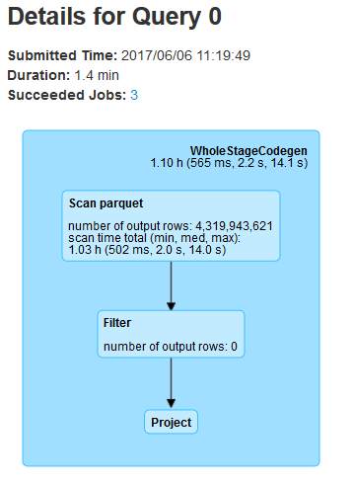
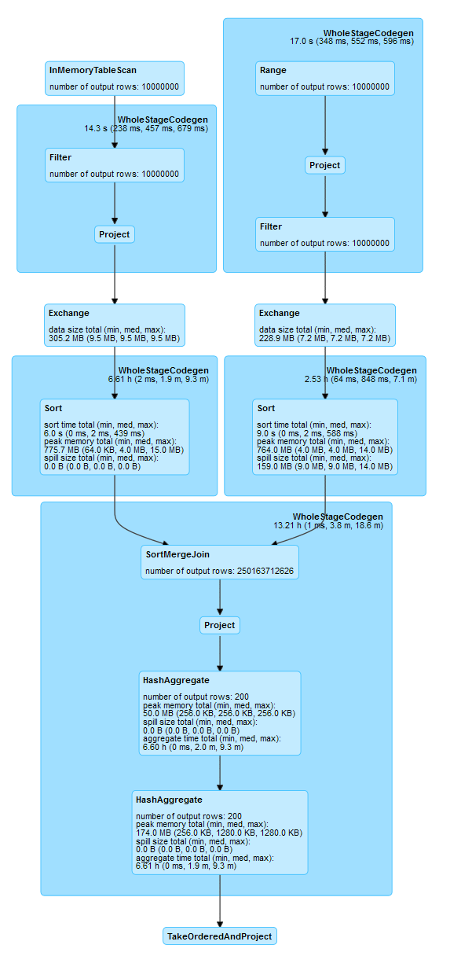
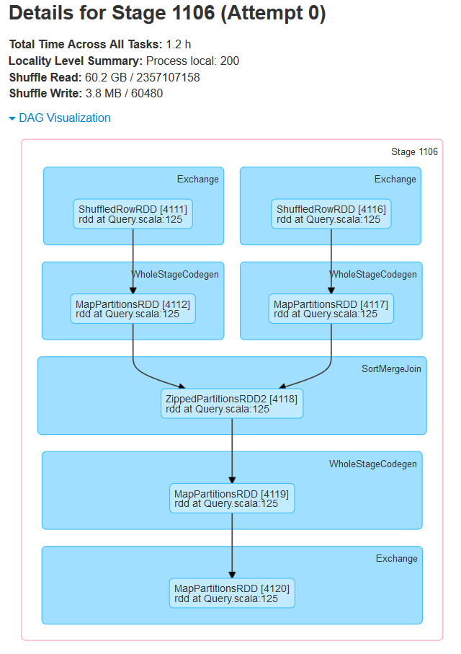
Execution Plans and DAGs

Slide 18
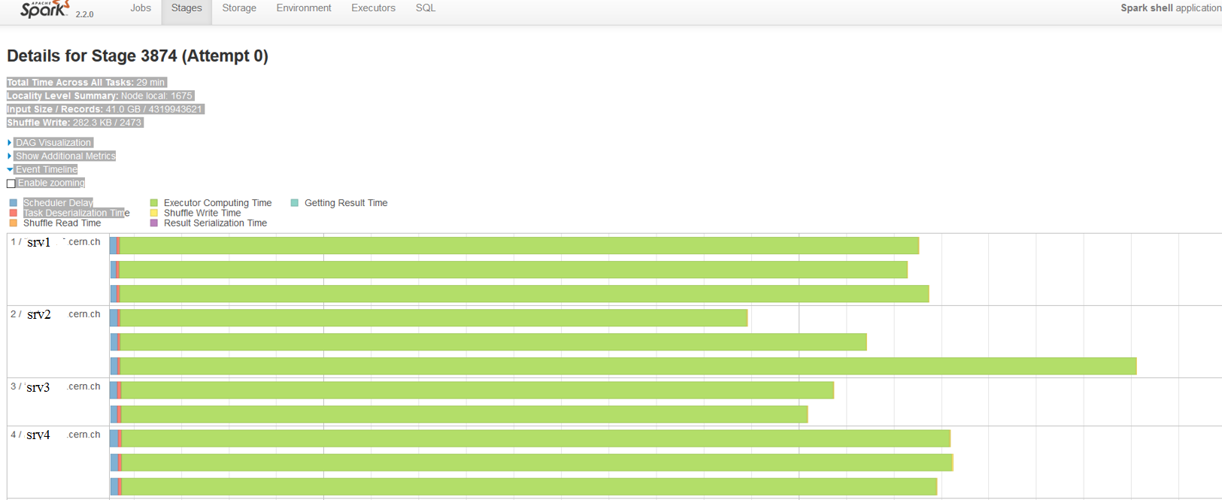
Web UI Event Timeline
Event Timeline
show task execution details by activity and time

Slide 19
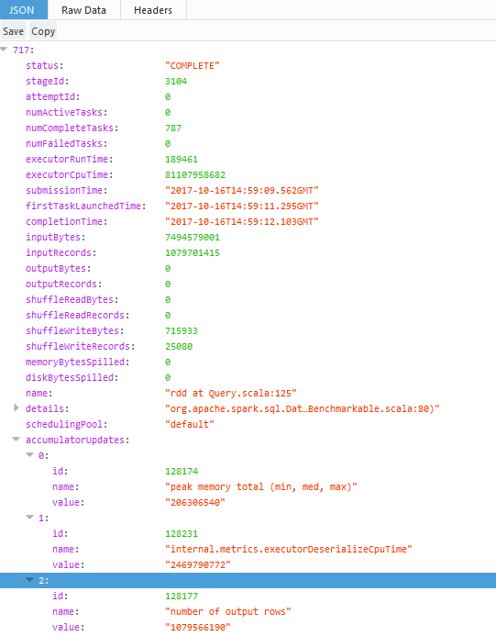
REST API – Spark Metrics
History server URL + /api/v1/applications
http://historyserver:18080/api/v1/applications/application_1507881680808_0002/stages

Slide 20
EventLog – Stores Web UI History
Config:
spark.eventLog.enabled=true
spark.eventLog.dir = <path>
JSON files store info displayed by Spark History server
You can read the JSON files with Spark task metrics and history with custom applications. For example sparklint.
You can read and analyze event log files using the Dataframe API with the Spark SQL JSON reader. More details at: https://github.com/LucaCanali/Miscellaneous/tree/master/Spark_Notes

Slide 21
Spark Executor Task Metrics
val df = spark.read.json("/user/spark/applicationHistory/application_...")
df.filter("Event='SparkListenerTaskEnd'").select("Task Metrics.*").printSchema
Task ID: long (nullable = true)
|-- Disk Bytes Spilled: long (nullable = true)
|-- Executor CPU Time: long (nullable = true)
|-- Executor Deserialize CPU Time: long (nullable = true)
|-- Executor Deserialize Time: long (nullable = true)
|-- Executor Run Time: long (nullable = true)
|-- Input Metrics: struct (nullable = true)
| |-- Bytes Read: long (nullable = true)
| |-- Records Read: long (nullable = true)
|-- JVM GC Time: long (nullable = true)
|-- Memory Bytes Spilled: long (nullable = true)
|-- Output Metrics: struct (nullable = true)
| |-- Bytes Written: long (nullable = true)
| |-- Records Written: long (nullable = true)
|-- Result Serialization Time: long (nullable = true)
|-- Result Size: long (nullable = true)
|-- Shuffle Read Metrics: struct (nullable = true)
| |-- Fetch Wait Time: long (nullable = true)
| |-- Local Blocks Fetched: long (nullable = true)
| |-- Local Bytes Read: long (nullable = true)
| |-- Remote Blocks Fetched: long (nullable = true)
| |-- Remote Bytes Read: long (nullable = true)
| |-- Total Records Read: long (nullable = true)
|-- Shuffle Write Metrics: struct (nullable = true)
| |-- Shuffle Bytes Written: long (nullable = true)
| |-- Shuffle Records Written: long (nullable = true)
| |-- Shuffle Write Time: long (nullable = true)
|-- Updated Blocks: array (nullable = true)
.. ..
Spark Internal Task metrics:
Provide info on executors’ activity:
Run time, CPU time used, I/O metrics, JVM Garbage Collection, Shuffle activity, etc.

Slide 22
Task Info, Accumulables, SQL Metrics
df.filter("Event='SparkListenerTaskEnd'").select("Task Info.*").printSchema
root
|-- Accumulables: array (nullable = true)
| |-- element: struct (containsNull = true)
| | |-- ID: long (nullable = true)
| | |-- Name: string (nullable = true)
| | |-- Value: string (nullable = true)
| | | . . .
|-- Attempt: long (nullable = true)
|-- Executor ID: string (nullable = true)
|-- Failed: boolean (nullable = true)
|-- Finish Time: long (nullable = true)
|-- Getting Result Time: long (nullable = true)
|-- Host: string (nullable = true)
|-- Index: long (nullable = true)
|-- Killed: boolean (nullable = true)
|-- Launch Time: long (nullable = true)
|-- Locality: string (nullable = true)
|-- Speculative: boolean (nullable = true)
|-- Task ID: long (nullable = true)
Accumulables are used to keep accounting of metrics updates, including SQL metrics
Details about the Task:
Launch Time, Finish Time, Host, Locality, etc

Slide 23
EventLog Analytics Using Spark SQL
Aggregate stage info metrics by name and display sum(values):
scala> spark.sql("select Name, sum(Value) as value from aggregatedStageMetrics group by Name order by Name").show(40,false)
+---------------------------------------------------+----------------+
|Name |value |
+---------------------------------------------------+----------------+
|aggregate time total (min, med, max) |1230038.0 |
|data size total (min, med, max) |5.6000205E7 |
|duration total (min, med, max) |3202872.0 |
|number of output rows |2.504759806E9 | |internal.metrics.executorRunTime |857185.0 |
|internal.metrics.executorCpuTime |1.46231111372E11|
|... |... |

Slide 24
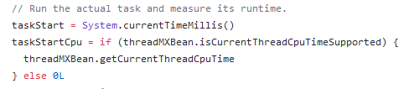
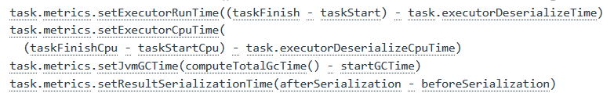
Drill Down Into Executor Task Metrics
Relevant code in Apache Spark - Core
Example snippets, show instrumentation in Executor.scala
Note, for SQL metrics, see instrumentation with code-generation

Slide 25
Read Metrics with sparkMeasure
sparkMeasure is a tool for performance investigations of Apache Spark workloads https://github.com/LucaCanali/sparkMeasure
$ bin/spark-shell --packages ch.cern.sparkmeasure:spark-measure_2.11:0.11
scala> val stageMetrics = ch.cern.sparkmeasure.StageMetrics(spark)
scala> stageMetrics.runAndMeasure(spark.sql("select count(*) from range(1000) cross join range(1000) cross join range(1000)").show)
Scheduling mode = FIFO
Spark Context default degree of parallelism = 8
Aggregated Spark stage metrics:
numStages => 3
sum(numTasks) => 17
elapsedTime => 9103 (9 s)
sum(stageDuration) => 9027 (9 s)
sum(executorRunTime) => 69238 (1.2 min)
sum(executorCpuTime) => 68004 (1.1 min)
. . . <more metrics>

Slide 26
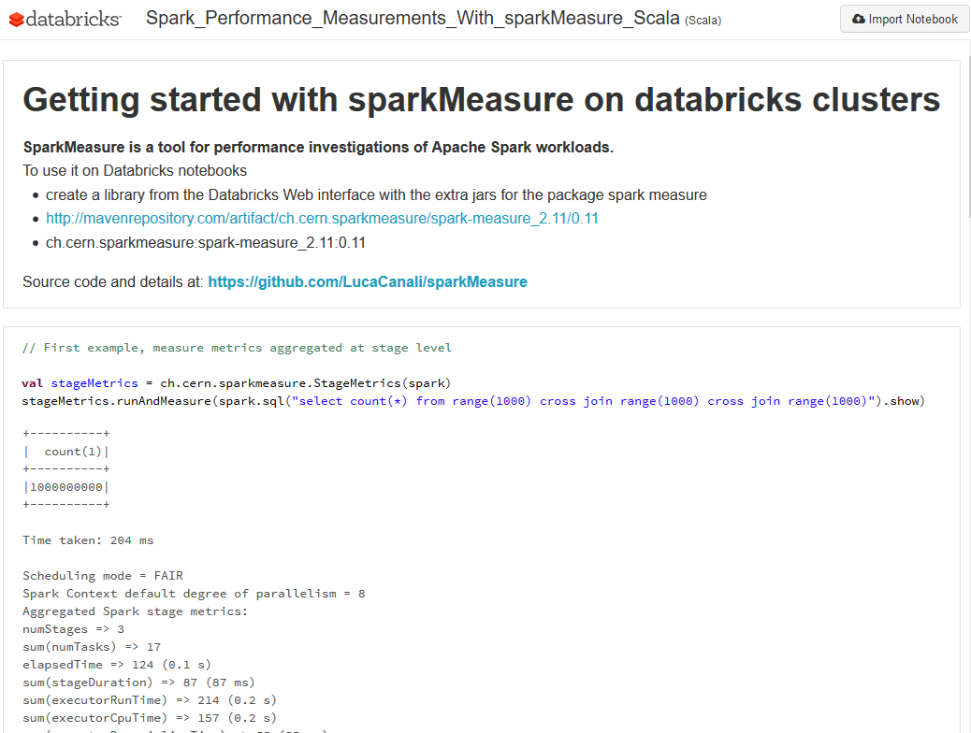
Notebooks and sparkMeasure
Interactive use: suitable for notebooks and REPL
Offline use: save metrics for later analysis
Metrics granularity: collected per stage or record all tasks
Metrics aggregation: user-defined, e.g. per SQL statement
Works with Scala and Python

Slide 27
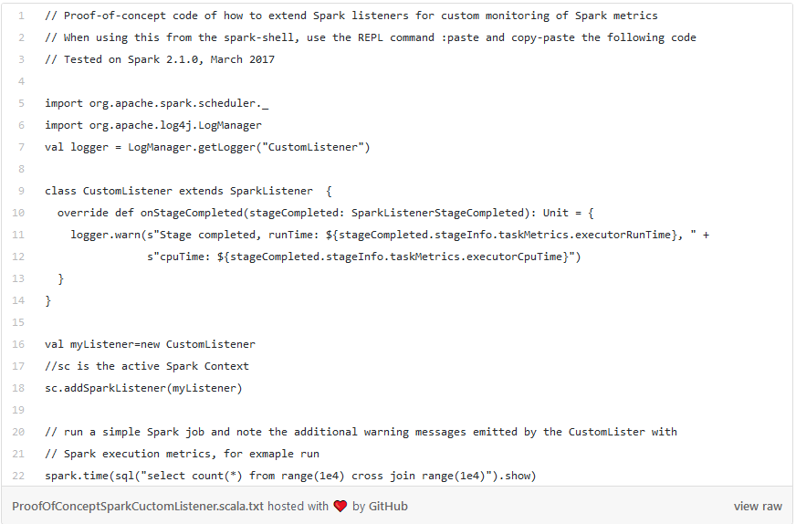
Collecting Info Using Spark Listener
- Spark Listeners are used to send task metrics from executors to driver
- Underlying data transport used by WebUI, sparkMeasure, etc
- Spark Listeners for your custom monitoring code

Slide 28
Examples – Parquet I/O
An example of how to measure I/O, Spark reading Apache Parquet files
This causes a full scan of the table store_sales
spark.sql("select * from store_sales where ss_sales_price=-1.0") .collect()
Test run on a cluster of 12 nodes, with 12 executors, 4 cores each
Total Time Across All Tasks: 59 min
Locality Level Summary: Node local: 1675
Input Size / Records: 185.3 GB / 4319943621
Duration: 1.3 min

Slide 29
Parquet I/O – Filter Push Down
Parquet filter push down in action
This causes a full scan of the table store_sales with a filter condition pushed down
spark.sql("select * from store_sales where ss_quantity=-1.0") .collect()
Test run on a cluster of 12 nodes, with 12 executors, 4 cores each
Total Time Across All Tasks: 1.0 min
Locality Level Summary: Node local: 1675
Input Size / Records: 16.2 MB / 0
Duration: 3 s

Slide 30
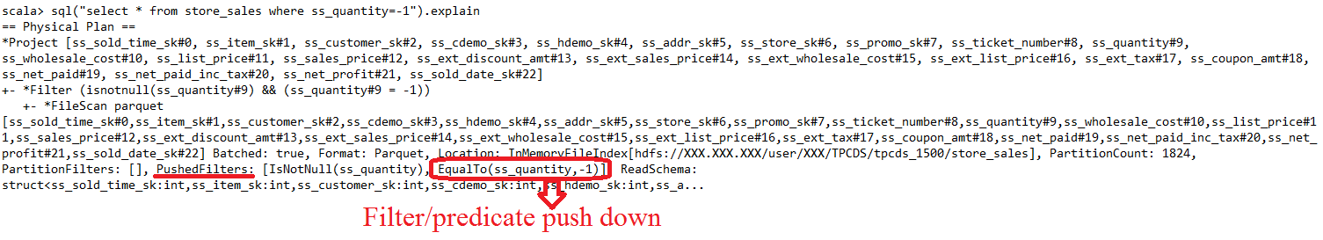
Parquet I/O – Drill Down
Parquet filter push down
I/O reduction when Parquet pushed down a filter condition and using stats on data (min, max, num values, num nulls)
Filter push down not available for decimal data type (ss_sales_price)
https://db-blog.web.cern.ch/blog/luca-canali/2017-06-diving-spark-and-parquet-workloads-example

Slide 31
CPU and I/O Reading Parquet Files
# echo 3 > /proc/sys/vm/drop_caches # drop the filesystem cache
$ bin/spark-shell --master local[1] --packages ch.cern.sparkmeasure:spark-measure_2.11:0.11 --driver-memory 16g
val stageMetrics = ch.cern.sparkmeasure.StageMetrics(spark)
stageMetrics.runAndMeasure(spark.sql("select * from web_sales where ws_sales_price=-1").collect())
Spark Context default degree of parallelism = 1 Aggregated Spark stage metrics: numStages => 1 sum(numTasks) => 787 elapsedTime => 465430 (7.8 min) sum(stageDuration) => 465430 (7.8 min) sum(executorRunTime) => 463966 (7.7 min) sum(executorCpuTime) => 325077 (5.4 min)
sum(jvmGCTime) => 3220 (3 s)
CPU time is 70% of run time
Note: OS tools confirm that the difference “Run”- “CPU” time is spent in read calls (used a SystemTap script)

Slide 32
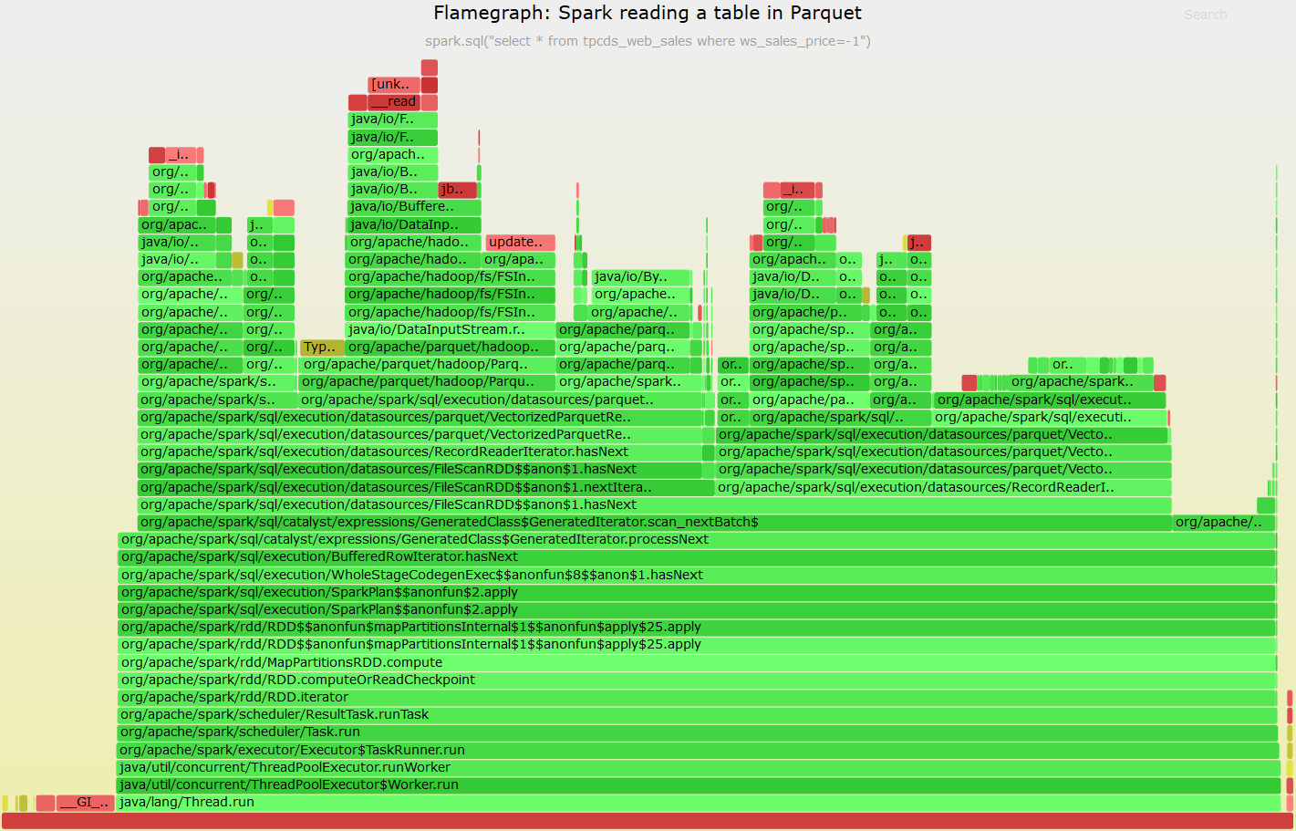
Stack Profiling and Flame Graphs
- Use stack profiling to investigate CPU usage
- Flame graph visualization to help identify “hot methods” and context (parent stack)
- Use profilers that don’t suffer from Java Safepoint bias, e.g. async-profiler
https://github.com/LucaCanali/Miscellaneous/blob/master/Spark_Notes/Tools_Spark_Linux_FlameGraph.md

Slide 33
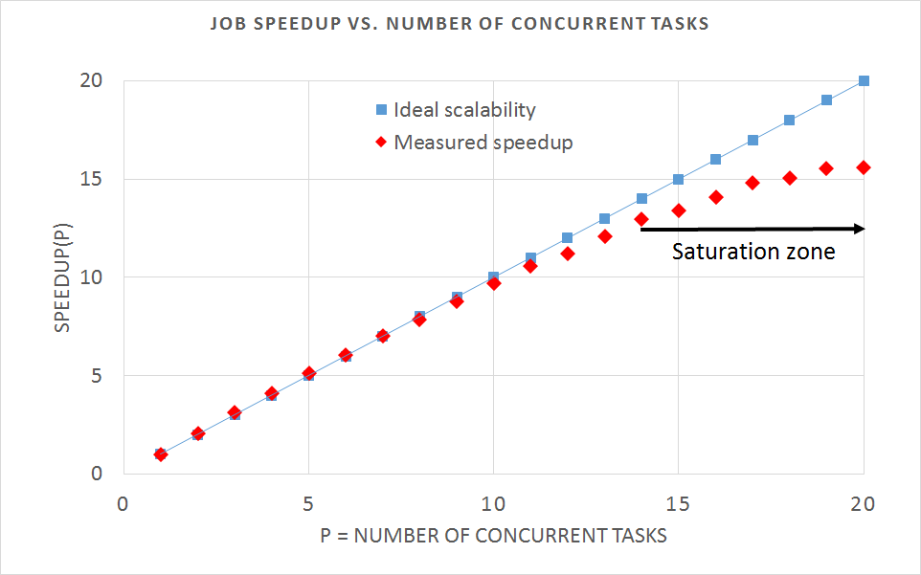
How Does Your Workload Scale?
Measure latency as function of N# of concurrent tasks
Example workload: Spark reading Parquet files from memory
Speedup(p) = R(1)/R(p)
Speedup grows linearly in ideal case. Saturation effects and serialization reduce scalability
(see also Amdhal’s law)

Slide 34
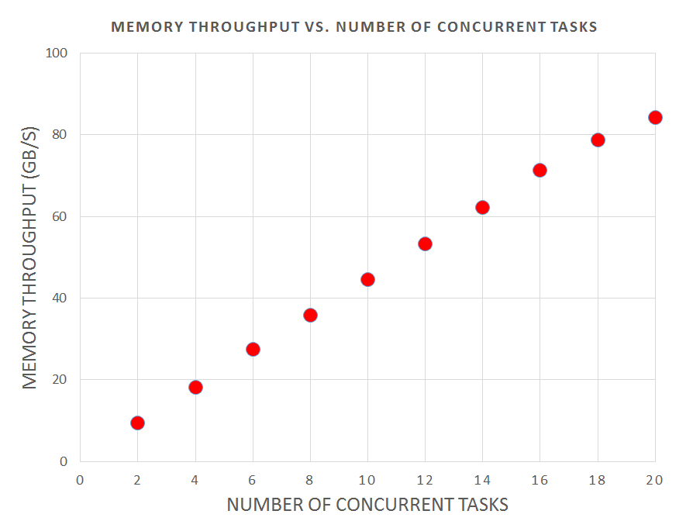
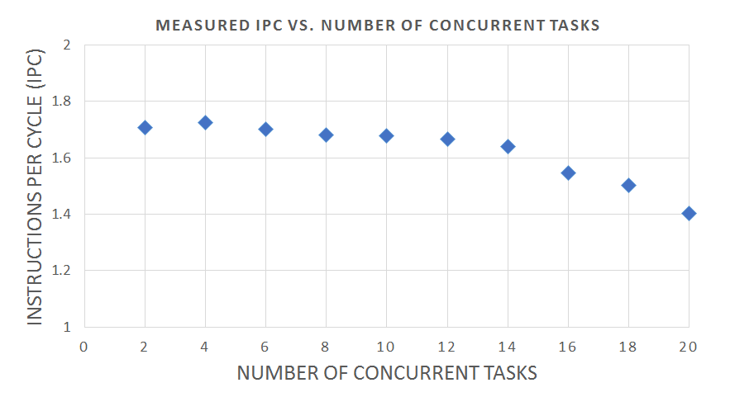
Are CPUs Processing Instructions or Stalling for Memory?
Measure Instructions per Cycle (IPC) and CPU-to-Memory throughput
Minimizing CPU stalled cycles is key on modern platforms
Tools to read CPU HW counters: perf and more
https://github.com/LucaCanali/Miscellaneous/blob/master/Spark_Notes/Tools_Linux_Memory_Perf_Measure.md
CPU-to-memory throughput close to saturation for this system
Increasing N# of stalled cycles at high load

Slide 35
Lessons Learned – Measuring CPU
Reading Parquet data is CPU-intensive
Measured throughput for the test system at high load (using all 20 cores)
about 3 GB/s – max read throughput with lightweight processing of parquet files
Measured CPU-to-memory traffic at high load ~80 GB/s
Comments:
CPU utilization and memory throughput are the bottleneck in this test
Other systems could have I/O or network bottlenecks at lower throughput
Room for optimizations in the Parquet reader code?
https://db-blog.web.cern.ch/blog/luca-canali/2017-09-performance-analysis-cpu-intensive-workload-apache-spark

Slide 36
Pitfalls: CPU Utilization at High Load
Physical cores vs. threads
CPU utilization grows up to the number of available threads
Throughput at scale mostly limited by number of available cores
Pitfall: understanding Hyper-threading on multitenant systems
Example data: CPU-bound workload (reading Parquet files from memory)
Test system has 20 physical cores
Job latency is roughly constant
Metric | 20 concurrent tasks | 40 concurrent tasks | 60 concurrent tasks
Elapsed time | 20 s | 23 s | 23 s
Executor run time | 392 s | 892 s | 1354 s
Executor CPU Time | 376 s | 849 s | 872 s
CPU-memory data volume | 1.6 TB | 2.2 TB | 2.2 TB
CPU-memory throughput | 85 GB/s | 90 GB/s | 90 GB/s
IPC | 1.42 | 0.66 | 0.63
Extra time from CPU runqueue wait
20 tasks -> each task gets a core
40 tasks -> they share CPU cores
It is as if CPU speed has become
2 times slower

Slide 37
Lessons Learned on Garbage Collection and CPU Usage
Measure: reading Parquet Table with “--driver-memory 1g” (default)
sum(executorRunTime) => 468480 (7.8 min)
sum(executorCpuTime) => 304396 (5.1 min)
sum(jvmGCTime) => 163641 (2.7 min)
OS tools: (ps -efo cputime -p <pid_of_SparkSubmit>)
CPU time = 2306 sec
Lessons learned:
Use OS tools to measure CPU used by JVM
Garbage Collection is memory hungry (size your executors accordingly)
Run Time =
CPU Time (executor) + JVM GC
Many CPU cycles used by JVM, extra CPU time not accounted in Spark metrics due to GC

Slide 38
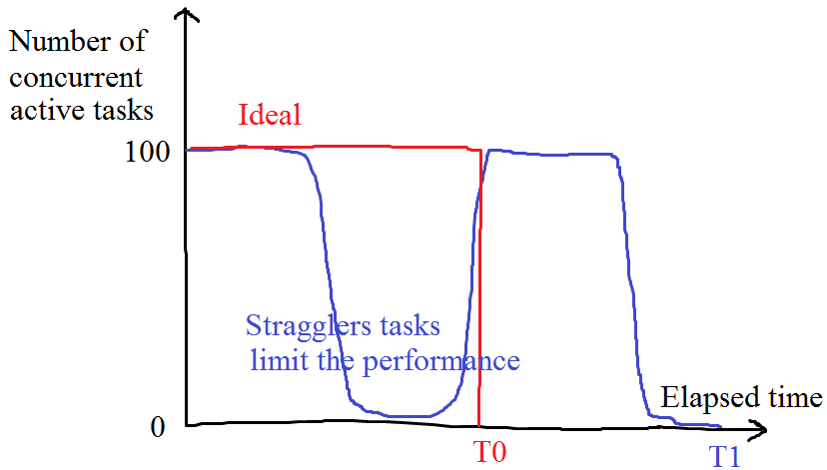
Performance at Scale: Keep Systems Resources Busy
Running tasks in parallel is key for performance
Important loss of efficiency when the number of concurrent active tasks << available cores

Slide 39
Issues With Stragglers
Slow running tasks - stragglers
Many causes possible, including
Tasks running on slow/busy nodes
Nodes with HW problems
Skew in data and/or partitioning
A few “local” slow tasks can wreck havoc in global perf
It is often the case that one stage needs to finish before the next one can start
See also discussion in SPARK-2387 on stage barriers
Just a few slow tasks can slow everything down

Slide 40
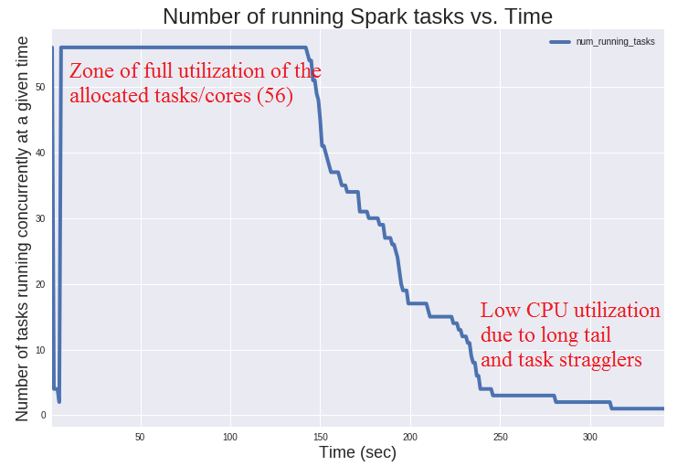
Investigate Stragglers With Analytics on “Task Info” Data
Example of performance limited by long tail and stragglers
Data source: EventLog or sparkMeasure (from task info: task launch and finish time)
Data analyzed using Spark SQL and notebooks
From https://db-blog.web.cern.ch/blog/luca-canali/2017-03-measuring-apache-spark-workload-metrics-performance-troubleshooting

Slide 41
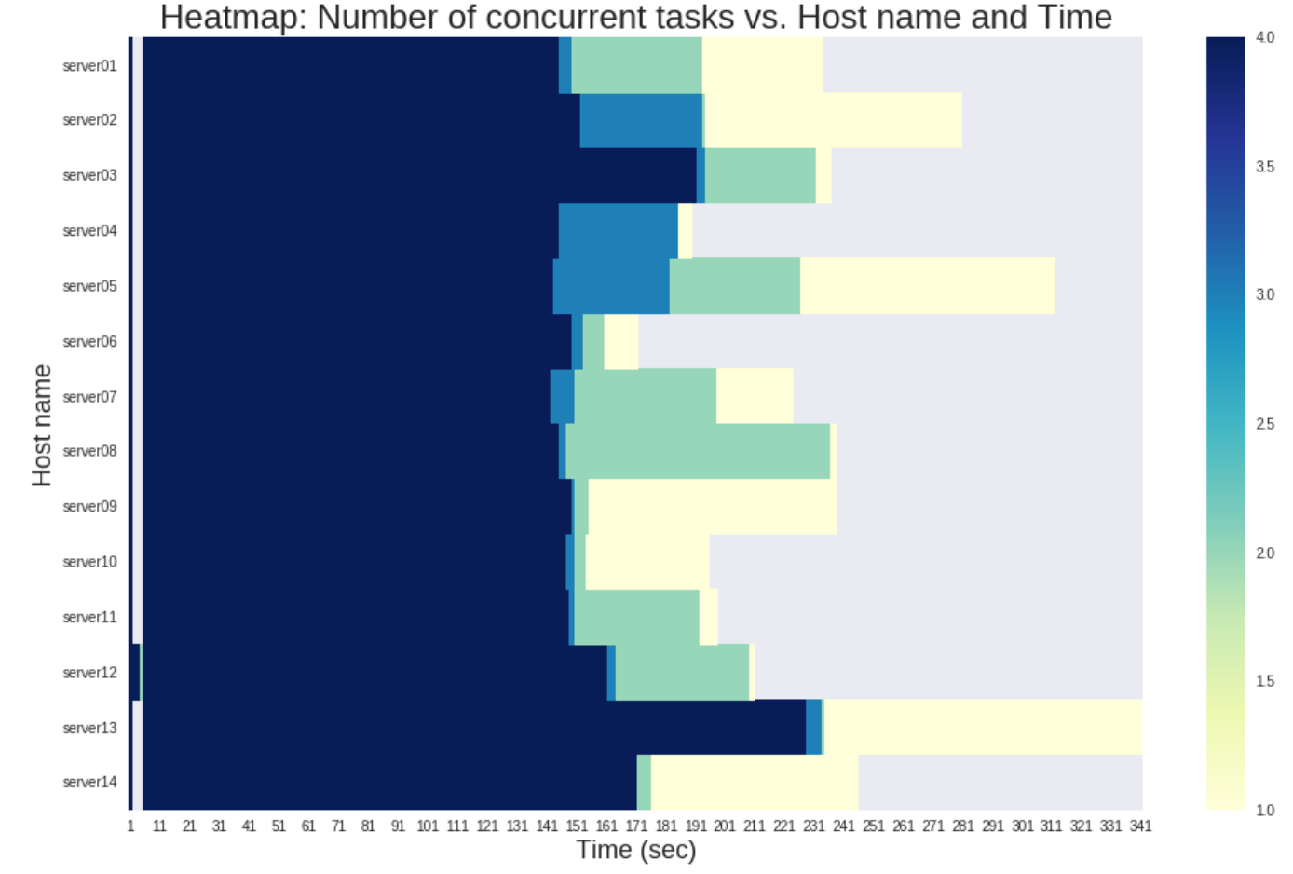
Task Stragglers – Drill Down
Drill down on task latency per executor:
it’s a plot with 3 dimensions
Stragglers due to a few machines in the cluster:
later identified as slow HW
Lessons learned: identify and remove/repair non-performing hardware from the cluster
From https://github.com/LucaCanali/sparkMeasure/blob/master/examples/SparkTaskMetricsAnalysisExample.ipynb

Slide 42
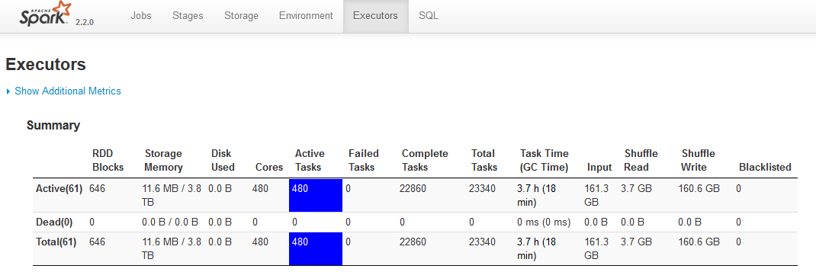
Web UI – Monitor Executors
The Web UI shows details of executors
Including number of active tasks (+ per-node info)
All OK: 480 cores allocated and 480 active tasks

Slide 43
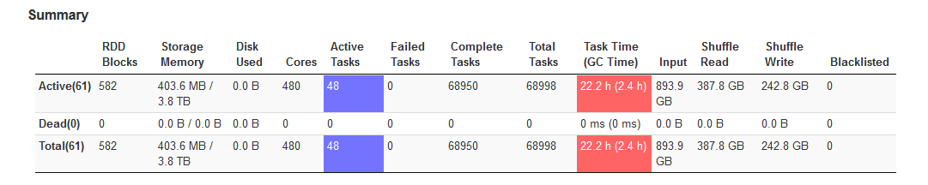
Example of Underutilization
Monitor active tasks with Web UI
Utilization is low at this snapshot:
480 cores allocated and 48 active tasks

Slide 44
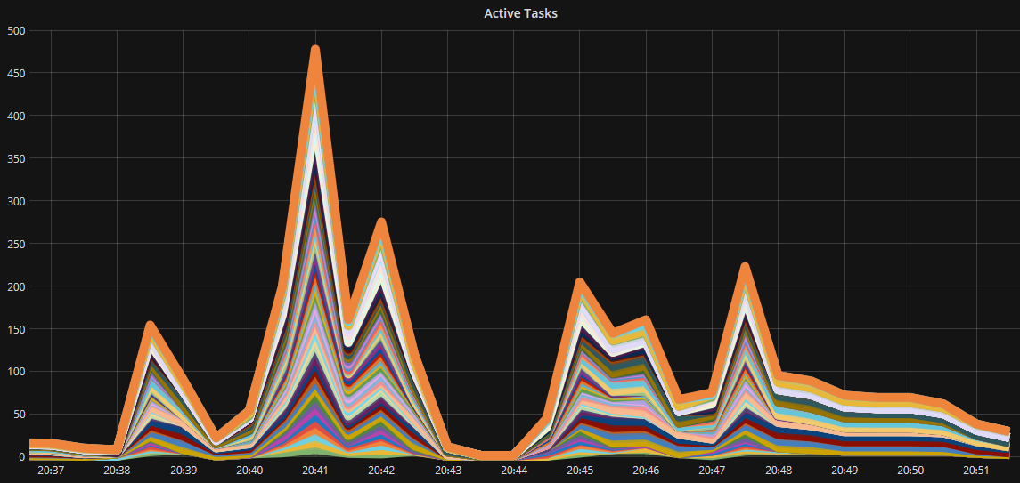
Visualize the Number of Active Tasks
Plot as function of time to identify possible under-utilization
Grafana visualization of number of active tasks for a benchmark job running on 60 executors, 480 cores
Data source: /executor/threadpool/activeTasks
Transport: Dropwizard metrics to Graphite sink

Slide 45
Measure the Number of Active Tasks With Dropwizard Metrics Library
The Dropwizard metrics library is integrated with Spark
Provides configurable data sources and sinks. Details in doc and config file “metrics.properties”
--conf spark.metrics.conf=metrics.properties
Spark data sources:
Can be optional, as the JvmSource or “on by default”, as the executor source
Notably the gauge: /executor/threadpool/activeTasks
Note: executor source also has info on I/O
Architecture
Metrics are sent directly by each executor -> no need to pass via the driver.
More details: see source code “ExecutorSource.scala”

Slide 46
Limitations and Future Work
Many important topics not covered here
Such as investigations and optimization of shuffle operations, SQL plans, etc
Understanding root causes of stragglers, long tails and issues related to efficient utilization of available cores/resources can be hard
Current tools to measure Spark performance are very useful.. but:
Instrumentation does not yet provide a way to directly find bottlenecks
Identify where time is spent and critical resources for job latency
See Kay Ousterhout on “Re-Architecting Spark For Performance Understandability”
Currently difficult to link measurements of OS metrics and Spark metrics
Difficult to understand time spent for HDFS I/O (see HADOOP-11873)
Improvements on user-facing tools
Currently investigating linking Spark executor metrics sources and Dropwizard sink/Grafana visualization (see SPARK-22190)

Slide 47
Conclusions
Think clearly about performance
Approach it as a problem in experimental science
Measure – build models – test – produce actionable results
Know your tools
Experiment with the toolset – active benchmarking to understand how your application works – know the tools’ limitations
Measure, build tools and share results!
Spark performance is a field of great interest
Many gains to be made + a rapidly developing topic

Slide 48
Acknowledgements and References
CERN
Members of Hadoop and Spark service and CERN+HEP users community
Special thanks to Zbigniew Baranowski, Prasanth Kothuri, Viktor Khristenko, Kacper Surdy
Many lessons learned over the years from the RDBMS community, notably www.oaktable.net
Relevant links
Material by Brendan Gregg (www.brendangregg.com)
More info: links to blog and notes at http://cern.ch/canali

